Slide 1
COOL MAPS
SPLASH 2013
Daniel Noble

Slide 2
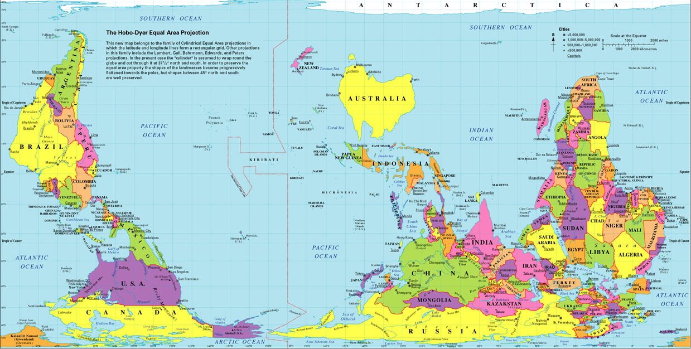
http://flourish.org/upsidedownmap/hobodyer-large.jpg

Slide 3
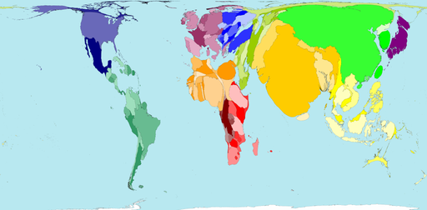
WORLD POPULATION
http://sasi.group.shef.ac.uk/worldmapper/display.php?selected=2

Slide 4
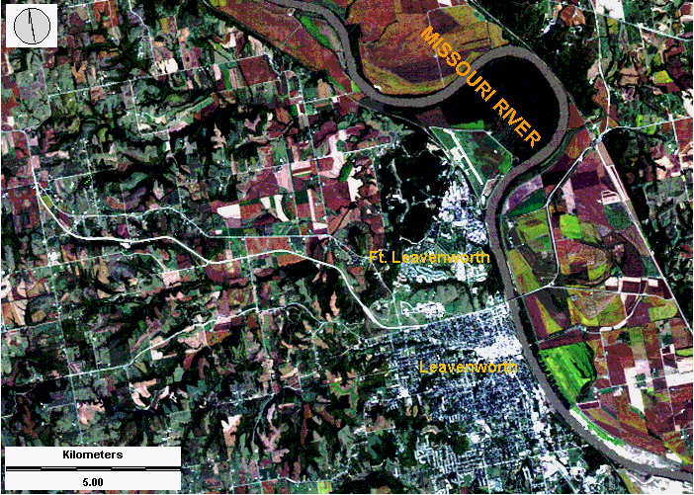
SATELLITE IMAGERY: VARIOUS WAVELENGTHS
http://www.geospectra.net/lewis_cl/remote/remote.htm

Slide 5
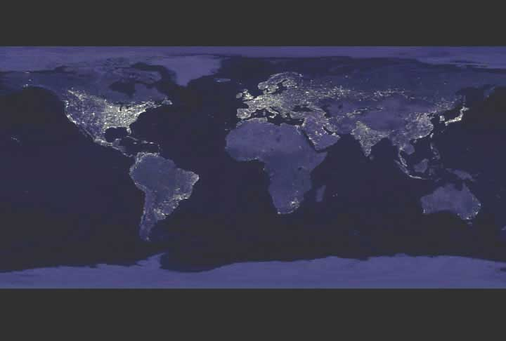
CITIES AT NIGHT
http://www.nasa.gov/images/content/49259main_flat_earth_nightm.jpe

Slide 6
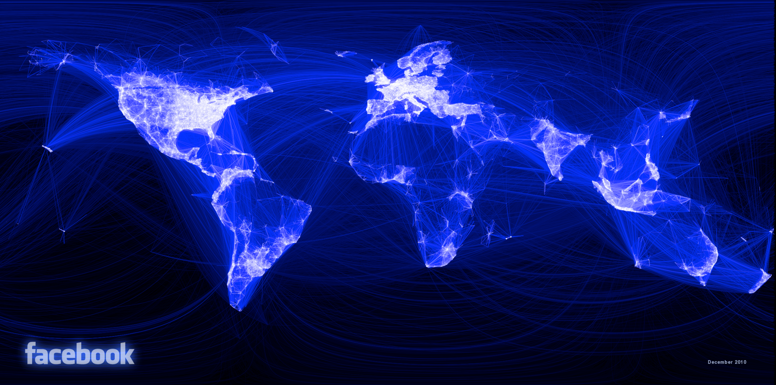
WORLD FRIENDSHIPS
https://www.facebook.com/note.php?note_id=469716398919

Slide 7
http://www.facebookstories.com/stories/1574/interactive-mapping-the-world-s-friendships#color=continent&story=1&country=IE

Slide 8
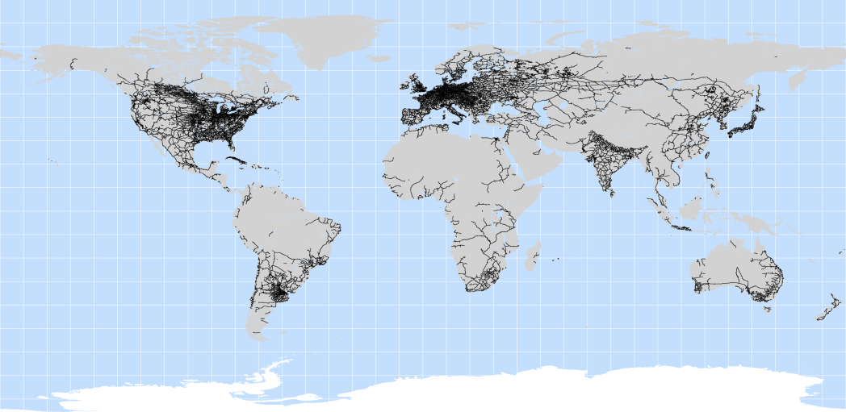
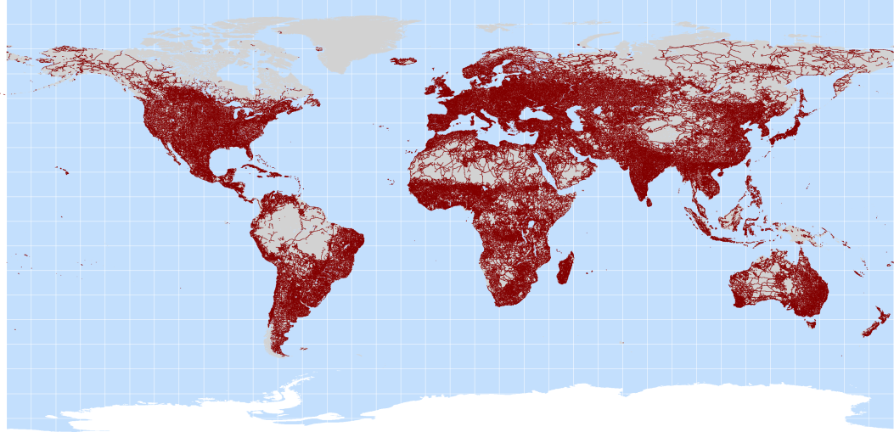
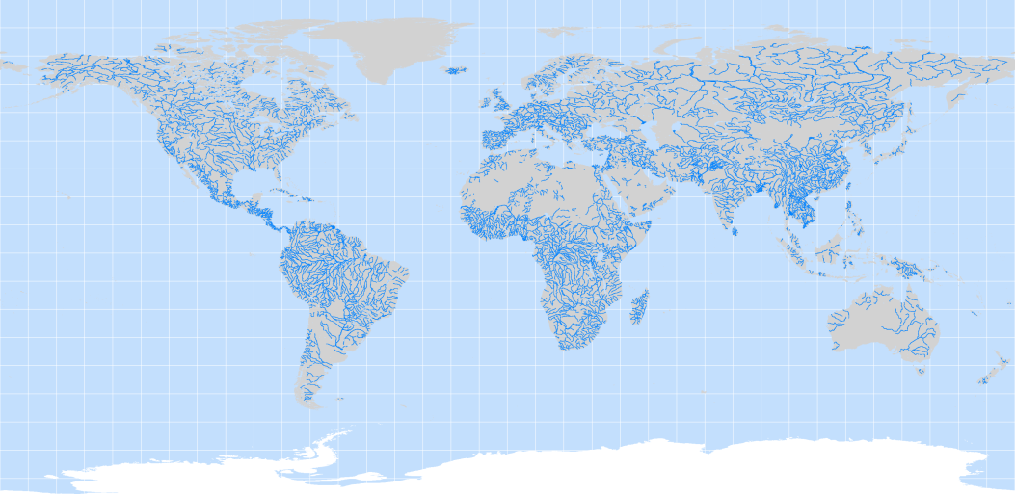
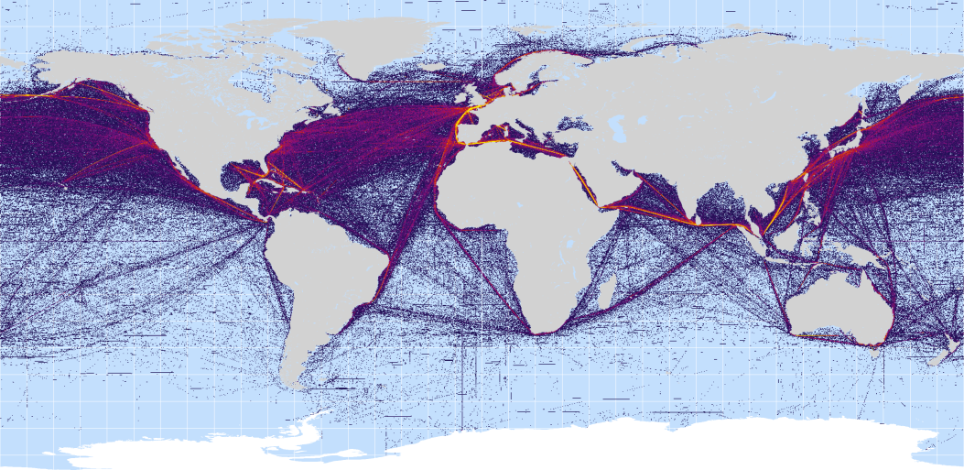
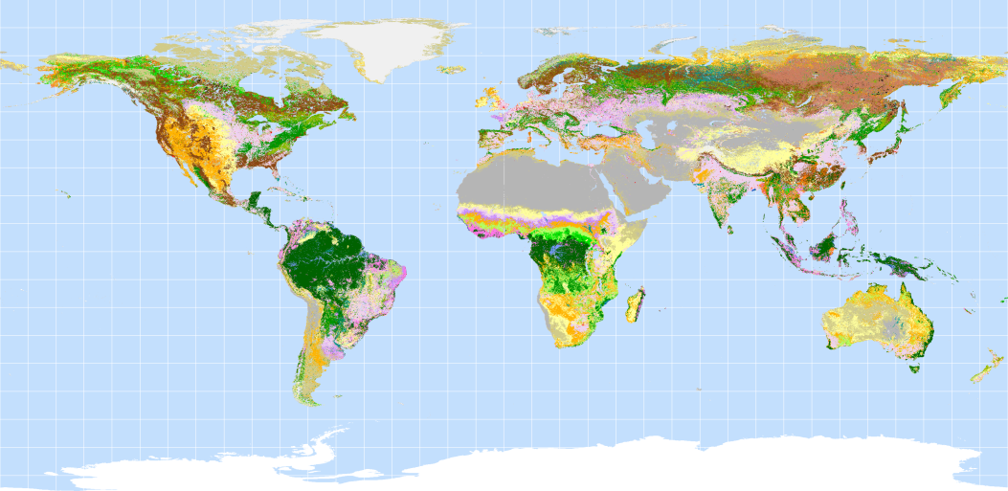
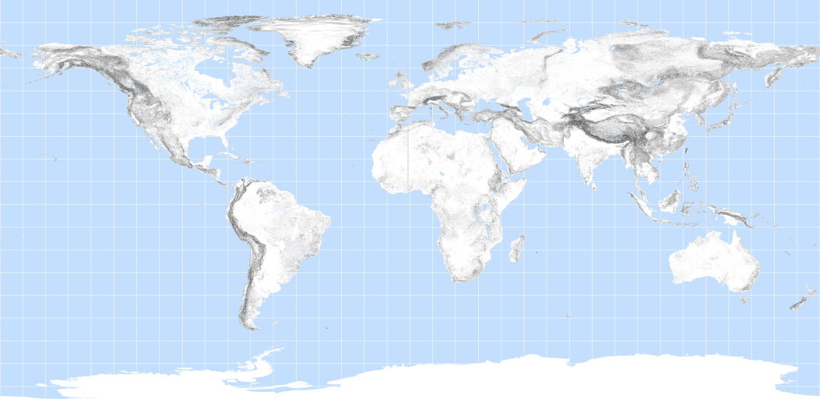

Slide 9
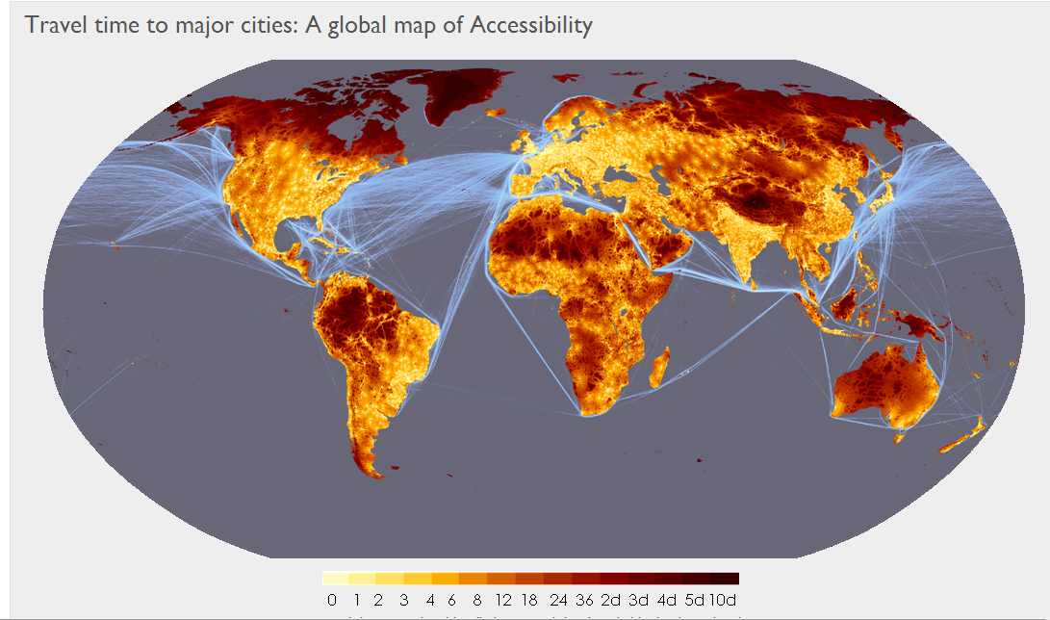
GLOBAL ACCESSABILITY
http://bioval.jrc.ec.europa.eu/products/gam/index.htm
Notes:
European Commission, Joint Research Centre

